Slide 1
EzCars ER Diagrams

Slide 2
Team1 : EzCars
List of Entities
Entity Name | Entity Primary Attributes
Users | userId, username, email, password, userPhone
Support Ticket | ticketId, userId, status, description
Vehicles | vehicleId, make, model, price, mileage
Make | makeId, makeName
Model | modelId, modelName, year
Bookings | bookingId, userId, vehicleId, pickUpDate
Payments | paymentId, bookingId, status, timeStamp
Ratings | ratingId, userId, vehicleId, rating, review

Slide 3
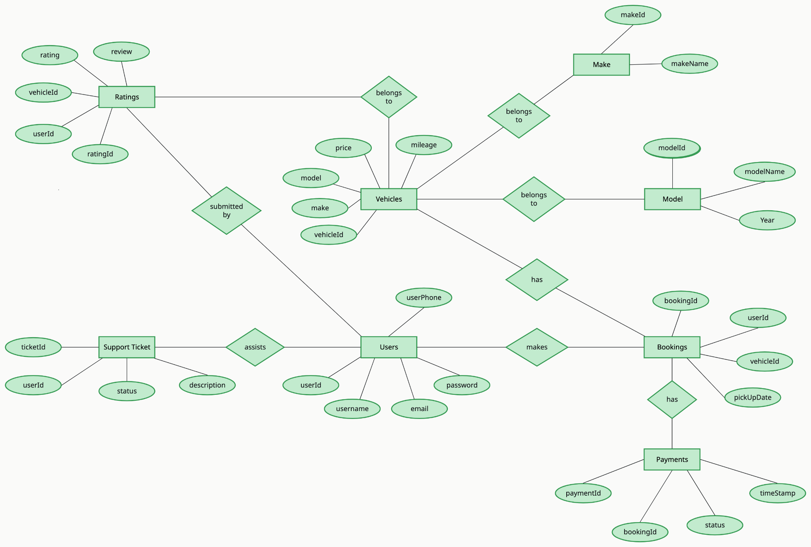
Team1 : EzCars
Conceptual ER Diagram

Slide 4
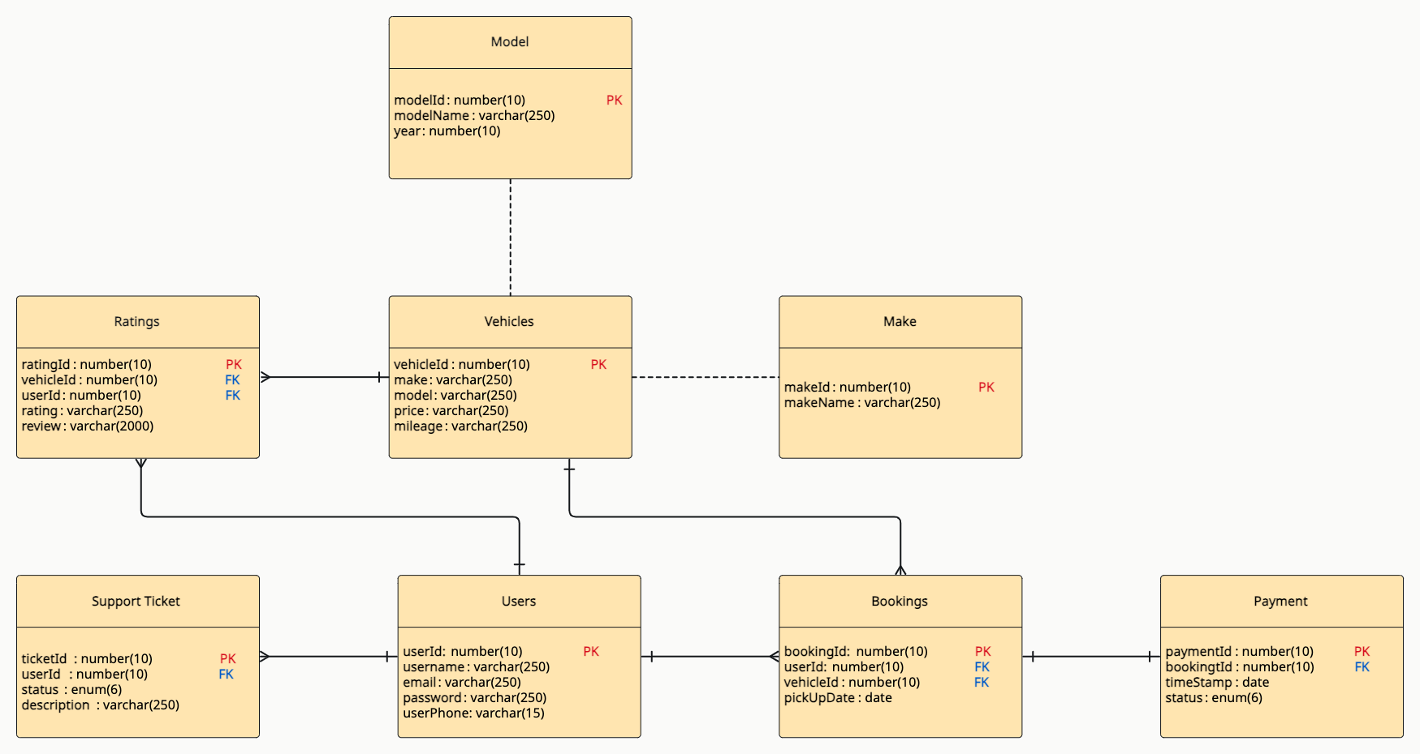
Team1 : EzCars
Logical ER Diagram

